Slide 1
Query Processing & Optimization

Slide 2
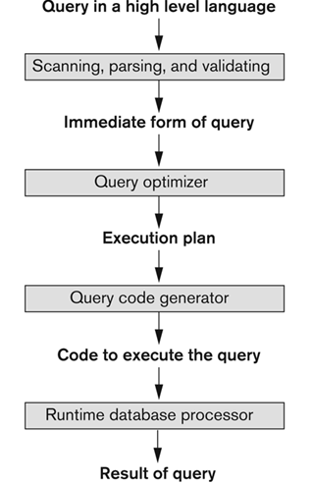
Typical steps in processing high level query

Slide 3
Typical steps in processing high level query
A query expressed in a high-level query language such as SQL must first be scanned, parsed, and validated.
The scanner identifies the query tokens—such as SQL keywords, attribute names, and relation names—that appear in the text of the query,
whereas the parser checks the query syntax to determine whether it is formulated according to the syntax rules (rules of grammar) of the query language.
The query must also be validated by checking that all attribute and relation names are valid and semantically meaningful names in the schema of the particular database being queried.

Slide 4
Typical steps in processing high level query
An internal representation of the query is then created, usually as a tree data structure called a query tree.
The DBMS must then devise an execution strategy for retrieving the results of the query from the database files.
A query typically has many possible execution strategies, and the process of choosing a suitable one for processing a query is known as query optimization.

Slide 5
Typical steps in processing high level query
The query optimizer module has the task of producing a good execution plan, and
the code generator generates the code to execute that plan.
The runtime database processor has the task of running (executing) the query code, whether in compiled or interpreted mode, to produce the query result. If a runtime error results, an error message is generated by the runtime database processor.

Slide 6
Query optimization
There two approaches to query optimization
1) Cost-based optimization
2) Heuristic optimization

Slide 7
Heuristic optimization
Heuristics are thumb rules
Optimizer uses thumb rules to find out the best execution strategy of a query.
The best execution strategy is called execution plan.

Slide 8
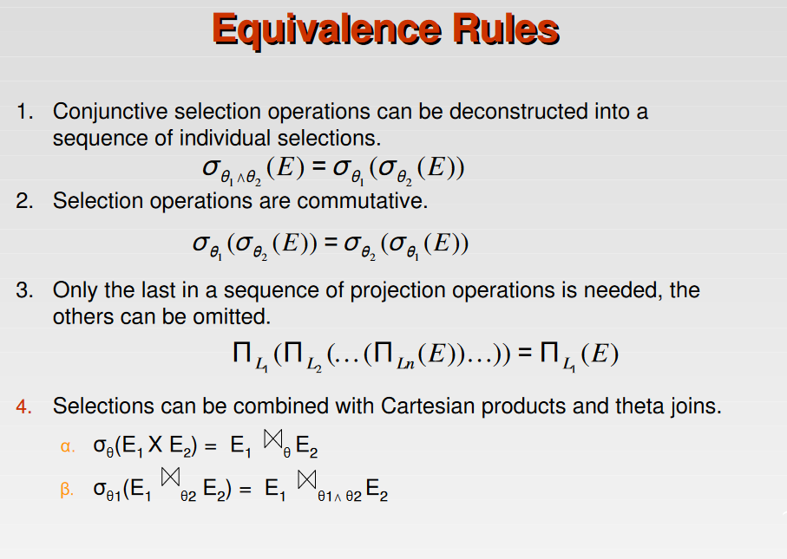

Slide 9
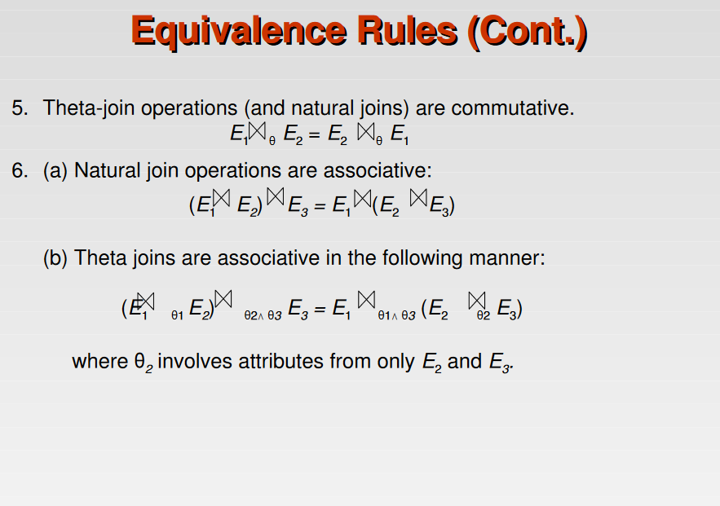

Slide 10
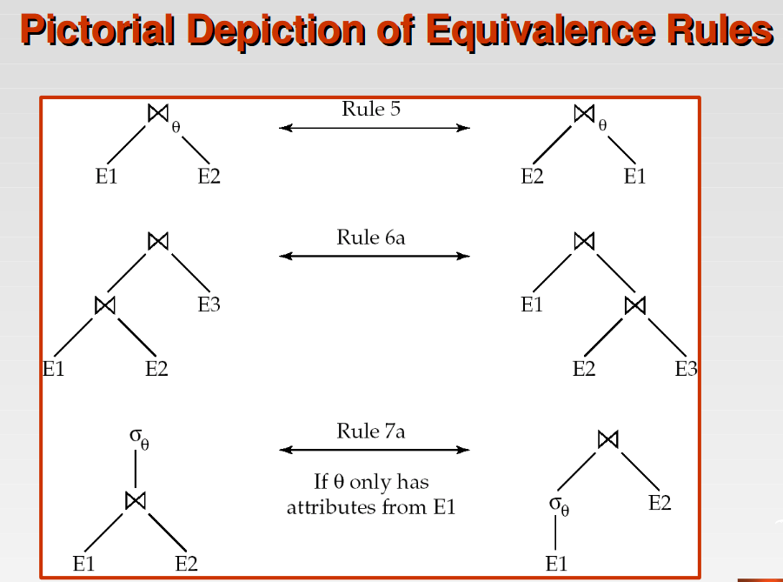

Slide 11
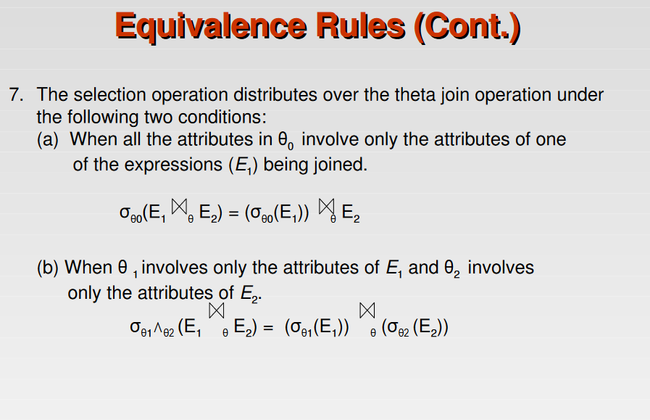

Slide 12
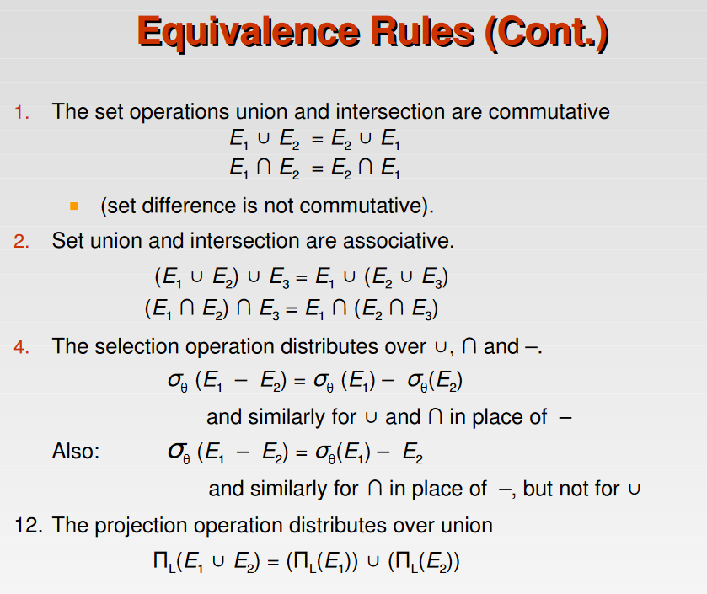

Slide 13
Examples of application of transformation rules
σ _{salary > 40000 and dno = 5}(employee) ≡ σ _{salary > 4000} (σ _{dno = 5}(employee))
σ _{salary > 40000} (σ_{dno = 5}(employee)) ≡ σ_{dno = 5} (σ _{salary > 40000} (employee))
π _{lname, fname, salary} (π _{lname, fname, salary, dno} (employee))
≡ π _{lname, fname, salary} (employee)
σ _{dno = dnumber} (employee × department)
≡ employee _{dno = dnumber} department

Slide 14
Heuristic optimization
SELECT LNAME
FROM EMPLOYEE, WORKS_ON, PROJECT
WHERE PNAME = ‘AQUARIUS’ AND PNUMBER = PNO
AND ESSN = SSN AND BDATE > ‘1990-12-31’;

Slide 15
Relational algebra expression
π _{Lname}(σPname=‘Aquarius’ Λ Pnumber=Pno Λ Essn=Ssn Λ Bdate > ‘1990-12-31’(employee × works_on × project))

Slide 16
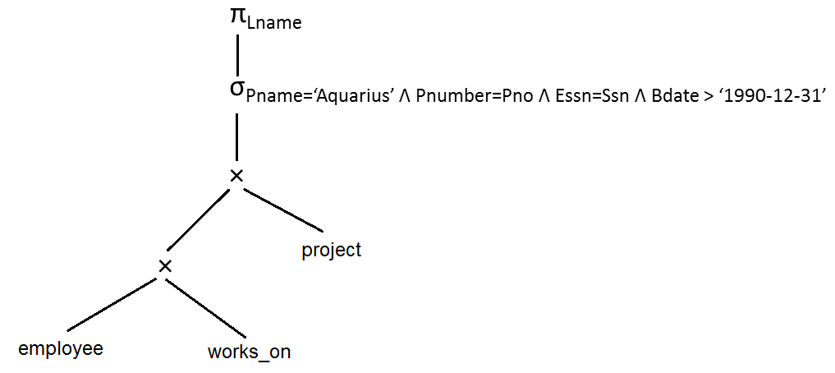
Query tree
Initial query tree

Slide 17
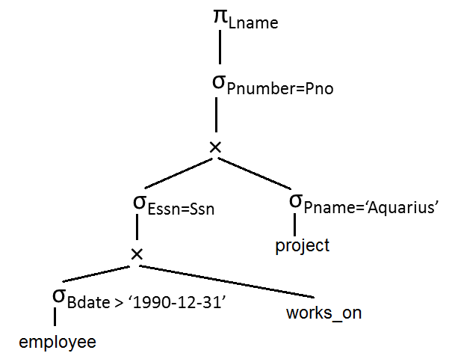
Heuristic optimization
Move the select operation down the tree as much as possible.

Slide 18
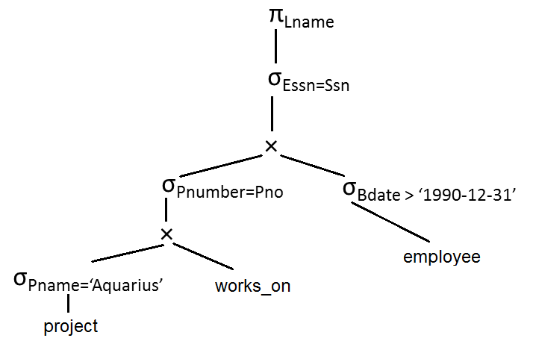
Heuristic optimization
Apply the most restrictive select operation first.

Slide 19
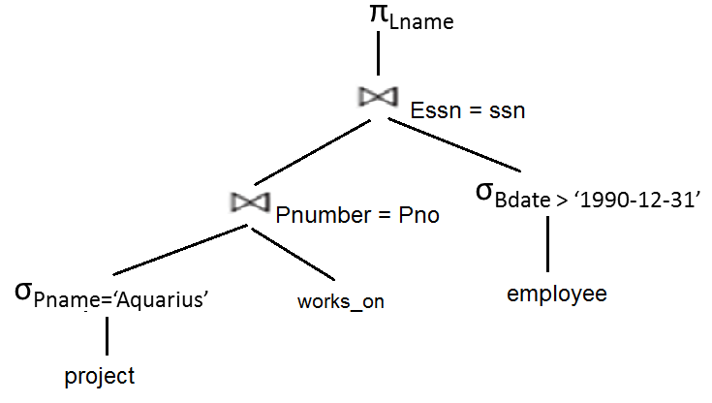
Heuristic optimization
Replace Cartesian product followed by join predicate by join operation.

Slide 20
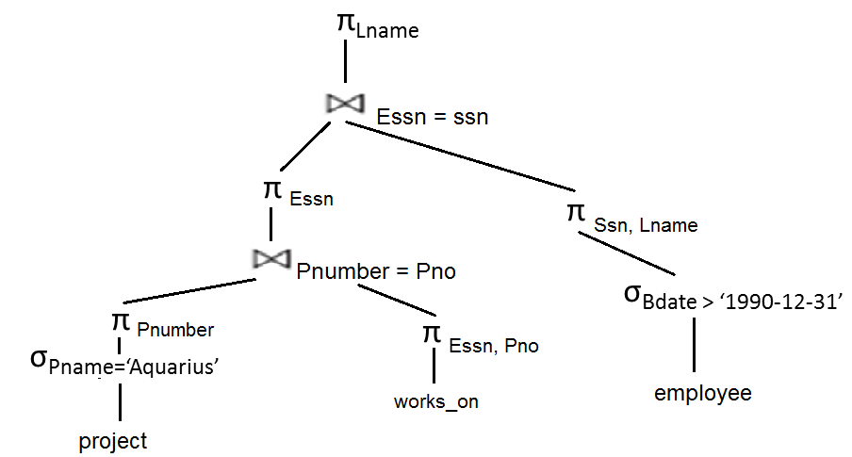
Heuristic optimization
Move project operation down the tree.

Slide 21
Heuristic optimization algorithm
An outline the algorithm:
Break up any select operations with conjunctive conditions into a cascade of select operations.
Move each select operation as far down the query tree as is permitted by the attributes involved in the select condition.
Rearrange the leaf nodes of the tree so that the leaf node relations with the most restrictive select operations are executed first in the query tree representation.
Combine a Cartesian product operation with a subsequent select operation in the tree into a join operation.
Break down and move lists of projection attributes down the tree as far as possible by creating new project operations as needed.

Slide 22

Exercise
Write down the expression for
relational algebra for the SQL statement and convert it into the best evaluation plan using heuristic optimization.

Slide 23
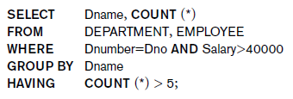
Exercise
Write down the expression for
relational algebra for the SQL statement
and convert it into the best evaluation
plan using heuristic optimization.

Slide 24
Relational algebra expression
π _{dname, count(*)} (Σ _{count(*) > 5} (_{dname} T_{count(*)}
(σ_{dnumber = dno Λ salary > 40000}(
employee × department))))

Slide 25
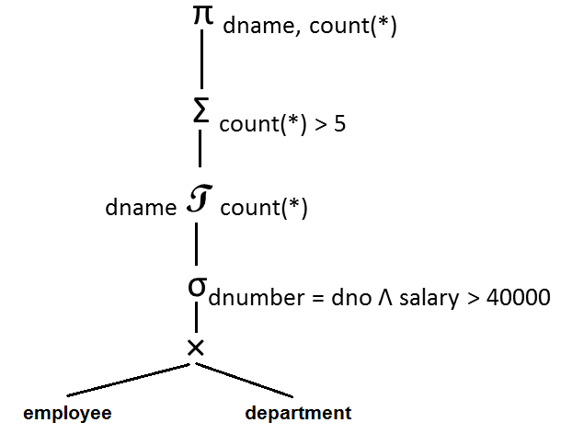
Heuristic optimization

Slide 26
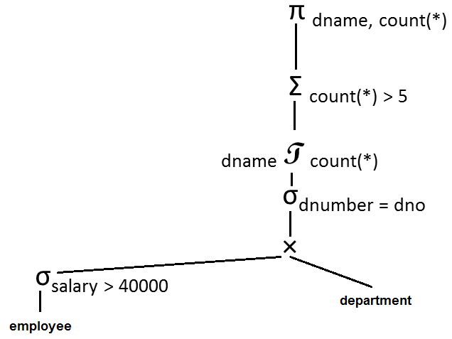
Heuristic optimization

Slide 27
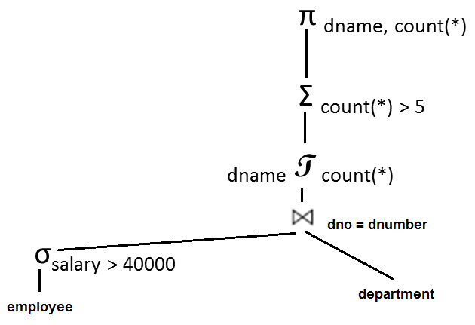
Heuristic optimization

